Slide 1
Lecture 2
The IP Protocol
IP Addressing

Slide 2
Introduction (Incomplete)
The Internet Protocol is one of the elements that define the Internet. The dominant internetworking protocol in the Internet Layer (fahim) in use today is IPv4; the number 4 is the protocol version number carried in every IP datagram.
IP versions 0 to 3 were experimental versions, used between 1977 and 1979.
Version 5 was used by the Internet Stream Protocol, an experimental streaming protocol.
The successor to IPv4 is IPv6.

Slide 3
Cont.
Its most prominent modification from version 4 is the addressing system.
IPv4 uses 32-bit addresses (c. 4 billion, or 4.3×10⁹, addresses) while IPv6 uses 128-bit addresses (c. 340 undecillion, or 3.4×10³⁸ addresses).
Although adoption of IPv6 has been slow, as of June 2008, all United States government systems have demonstrated basic infrastructure support for IPv6 (if only at the backbone level).

Slide 4
Cont.
IPv6 was a result of several years of experimentation and dialog during which various protocol models were proposed, such as IPv7 known as TP/IX (The Next Internet) (RFC 1475), IPv8 PIP (RFC 1621) and IPv9 TUBA (TCP and UDP with Bigger Addresses, RFC 1347).

Slide 5
IP Address
An IP address is a unique global address for a network interface
Connection-less protocol used on packet-switched (Shamim) link layer networks
An IP address:
- is a 32 bit long identifier
      2³² combinations
      Nearly 4.3 billion
encodes a network number (network prefix)
and a host number

Slide 6
Rule
If a protocol uses N bits to define an address, the address space is 2^{N} because each bit can have two different values (0 and 1) and N bits can have 2^{N} values.
The address space of IPv4 is 2³² or 4,294,967,296.
Binary Notation

Slide 7
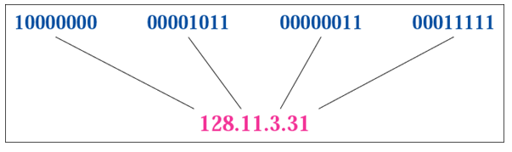
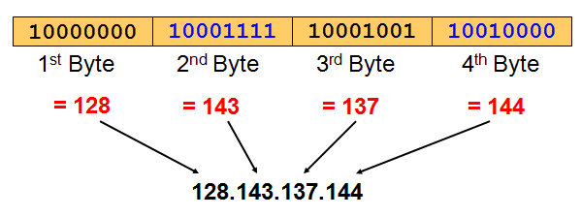
Dotted-decimal notation
IP addresses are written in a so-called dotted decimal notation
Each byte is identified by a decimal number in the range [0..255].

Slide 8
Problem
Find the error, if any, in the following IP address:
111.56.045.78
Solution
There are no leading zeroes in dotted-decimal notation (045).

Slide 9
Problem
Find the error, if any, in the following IP address:
75.45.301.14
Solution
In dotted-decimal notation, each number is less than or equal to 255; 301 is outside this range.

Slide 10

The Two Parts of an IP Address
An IP address consists of two parts:
Network prefix: The class ID plus network ID portions of the IP address are known as the network prefix
Host number
Network prefix identifies the network and host number identifies the node, or host on the network.

Slide 11
How do we know how long the network prefix is?
The network prefix is implicitly defined by class-based addressing.
The network prefix is indicated by a netmask.
The Class of the address determines which part belongs to the network address and which part belongs to the node address. All nodes on a given network share the same network prefix but must have a unique host number.

Slide 12

The old way: Classful IP Addresses
When Internet addresses were standardized (early 1980s), the Internet address space was divided up into classes:
Class A Network
In a Class A Network binary address start with 0, therefore the decimal number can be anywhere from 0 to 126 (01111110). The number 127 (01111111) is reserved for loopback and is used for internal testing on the local machine. Class A addresses have 8 bit network prefix sometimes referred to as “/8”. The remaining 24 bits indicate the host within the network. An example of a Class A IP address is 102.168.212.226, where "102" identifies the network and "168.212.226" identifies the host on that network.

Slide 13
Problem
How can we prove that we have 2,147,483,648 addresses in class A?
Solution
In class A, only 1 bit defines the class. The remaining 31 bits are available for the address.
With 31 bits, we can have 2³¹ or 2,147,483,648 addresses.

Slide 14

Class B Network
In a Class B Network, binary addresses start with 10, therefore the decimal number can be anywhere from 128 (10000000) to 191 (10111111). The first 16 bits (the first two octets) identify the network and the remaining 16 bits indicate the host within the network. An example of a Class B IP address is 168.212.226.204 where "168.212" identifies the network and "226.204" identifies the host on that network.

Slide 15
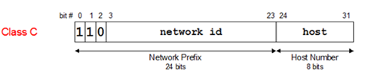
Class C Network
Binary addresses start with 110, therefore the decimal number can be anywhere from 192 (11000000) to 223 (11011111). The first 24 bits (the first three octets) identify the network and the remaining 8 bits indicate the host within the network. An example of a Class C IP address is 200.168.212.226 where "200.168.212" identifies the network and "226" identifies the host on that network.

Slide 16


Class D Network
Class D addresses are used for multicasting; there is only one block in this class.
Class E Network
Class E addresses are reserved for special purposes.

Slide 17
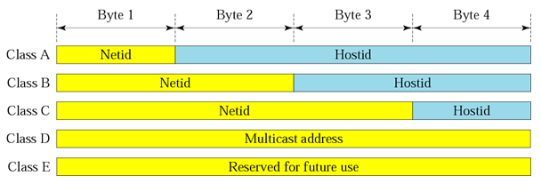
Classful IP Addresses

Slide 18
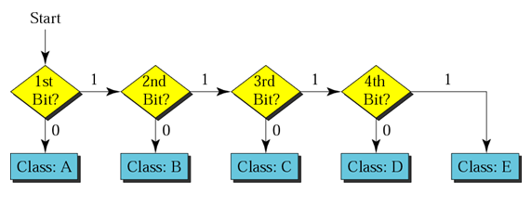
Finding the address class

Slide 19
Problem
Find the class of the address:
00000001 00001011 00001011 11101111
Solution
The first bit is 0. This is a class A address.
Problem
Find the class of the address:
11000001 10000011 00011011 11111111
Solution
The first 2 bits are 1; the third bit is 0. This is a class C address.

Slide 20
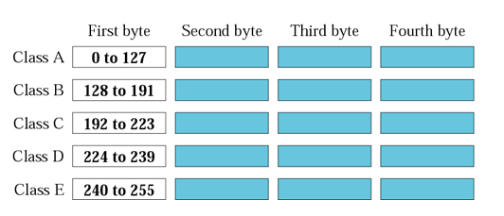
Finding the class in decimal notation

Slide 21
Problem
Find the class of the address: 227.12.14.87
Solution
The first byte is 227 (between 224 and 239); the class is D
Problem
Find the class of the address: 193.14.56.22
Solution
The first byte is 193 (between 192 and 223); the class is C.

Slide 22
Network Addresses
The network address is the first address.
The network address defines the network to the rest of the Internet.
Given the network address, we can find the class of the address, the block, and the range of the addresses in the block
In classful addressing, the network address (the first address in the block) is the one that is assigned to the organization.

Slide 23
Problem
Given the network address 17.0.0.0, find the class, the block, and the range of the addresses.
Solution
The class is A because the first byte is between 0 and 127. The block has a netid of 17 (00010001). The addresses range from 17.0.0.0 to 17.255.255.255.

Slide 24
Problem
Given the network address 132.21.0.0, find the class, the block, and the range of the addresses.
Solution
The class is B because the first byte is between 128 and 191. The block has a netid of 132.21. The addresses range from 132.21.0.0 to 132.21.255.255.

Slide 25
Problem
Given the network address 220.34.76.0, find the class, the block, and the range of the addresses.
Solution
The class is C because the first byte is between 192 and 223. The block has a netid of 220.34.76. The addresses range from 220.34.76.0 to 220.34.76.255.

